Slide 1
Statistics Micro Mini
Multiple Regression
January 5-9, 2008
Beth Ayers
January 6, 2009 - morning session

Slide 2
Tuesday 9am-12pm Session
Critique of An Experiment in Grading Papers
Review of simple linear regression
Introduction to Multiple regression
  Assumptions
  Model checking
  R²
  Multicollinearity
January 6, 2009 - morning session

Slide 3
Simple Linear Regression
Both the response and explanatory variable are quantitative
Graphical Summary
  Scatter plot
Numerical Summary
  Correlation
  R²
  Regression equation
    Response = ¯₀ + ¯₁ ¢ explanatory
Test of significance
  Test significance of regression equation coefficients
January 6, 2009 - morning session

Slide 4
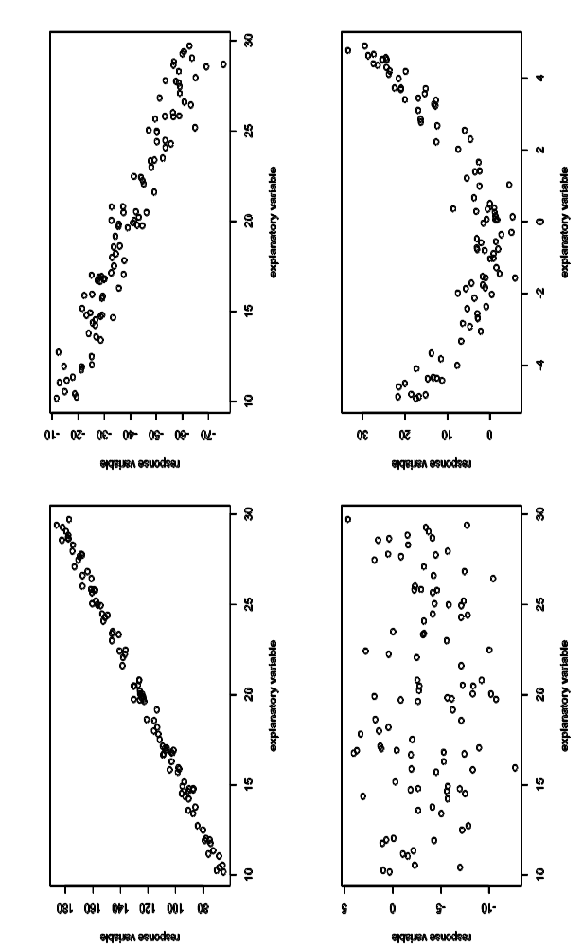
Scatter plot
Shows relationship between two quantitative variables
  y-axis = response variable
  x-axis = explanatory variable
January 6, 2009 - morning session

Slide 5
Correlation and R²
Correlation indicates the strength and direction of the linear relationship between two quantitative variables
  Values between -1 and +1
R² is the fraction of the variability in the response that can be explained by the linear relationship with the explanatory variable
  Values between 0 and +1
Correlation² = R²
Large values of each depend on the field
January 6, 2009 - morning session

Slide 6
Linear Regression Equation
Linear Regression Equation
  Response = ¯₀ + ¯₁ * explanatory
  ¯₀ is the intercept
    the value of the response variable when the explanatory variable is 0
  ¯₁ is the slope
    For each 1 unit increase in the explanatory variable, the response variable increases by ¯₁
¯₀ and ¯₁ are most often found using least squares estimation
January 6, 2009 - morning session

Slide 7
Assumptions of linear regression
Linearity
  Check my looking at either observed vs. predicted or residual vs. predicted plot
  If non-linear, predictions will be wrong
Independence of errors
  Can often be checked by knowing how data was collected. If not sure can use autocorrelation plots.
Homoscedasticity (constant variance)
  Look at residuals versus predicted plot
  If non-constant variance predictions will have wrong confidence intervals and estimated coefficients may be wrong
Normality of errors
  Look at normal probability plot
  If non-normal confidence intervals and estimated coefficients will be wrong
January 6, 2009 - morning session

Slide 8
Assumptions of linear regression
If the assumptions are not met, the estimates of ¯₀, ¯₁, their standard deviations, and estimates of R² will be incorrect
Maybe possible to do transformations to either the explanatory or response variable to make the relationship linear
January 6, 2009 - morning session

Slide 9
Hypothesis testing
Want to test if there is a significant linear relationship between the variables
  H₀ = there is no linear relationship between the variables (¯₁ = 0)
  H₁ = there is a linear relationship between the variables (¯₁ ≠ 0)
Testing ¯₀ = 0 may or may not be interesting and/or valid
January 6, 2009 - morning session

Slide 10
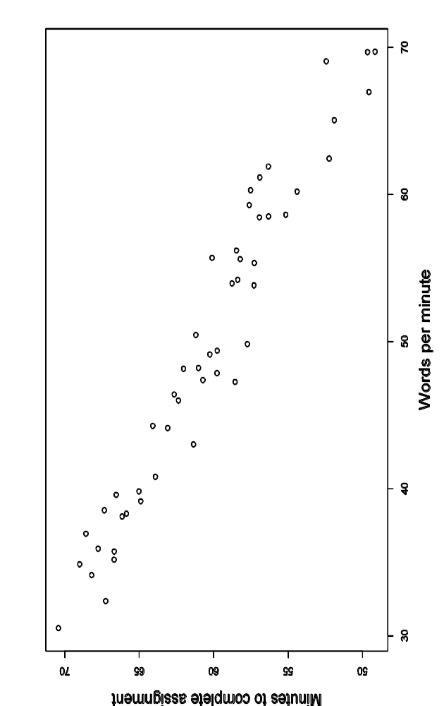
Monday’s Example
Curious if typing speed (words per minute) affects efficiency (as measured by number of minutes required to finish a paper)
Graphical display
January 6, 2009 - morning session

Slide 11
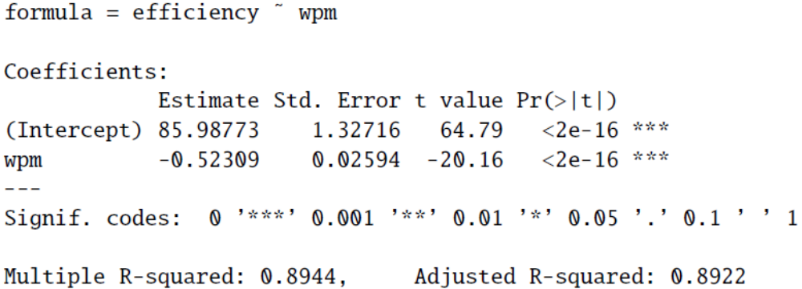
Sample Output
Below is sample output for this regression
January 6, 2009 - morning session

Slide 12
Numerical Summary
Numerical summary
  Correlation = -0.946
  R² = 0.8944
  Efficiency = 85.99 – 0.52*speed
For each additional word per minute typed, the number of minutes needed to complete an assignment decreases by 0.52 minutes
The intercept does not make sense since it corresponds to a speed of zero words per minute
January 6, 2009 - morning session

Slide 13
Interpretation of r and R²
r = -0.946
  This indicates a strong negative linear relationship
R² = 89.44
  89.44% of the variability in efficiency can be explained by words per minute typed
January 6, 2009 - morning session

Slide 14
Hypothesis test
To test the significance of ¯₁
  H₀ = there is no linear relationship between the speed and efficiency (¯₁ = 0)
  H₁ = there is a linear relationship between the speed and efficiency (¯₁ ≠ 0)
Test statistic: t = -20.16
P-value = 0.000
In this case, testing ¯₀ = 0 is not interesting; however it may be in some experiments
January 6, 2009 - morning session

Slide 15
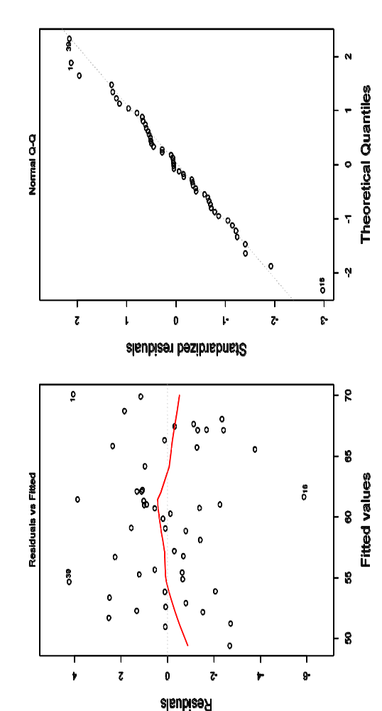
Checking Assumptions
Checking assumptions
  Plot on left: residual vs. predicted
    Want to see no pattern
  Plot on right: normal probability plot
    Want to see points fall on line
January 6, 2009 - morning session

Slide 16
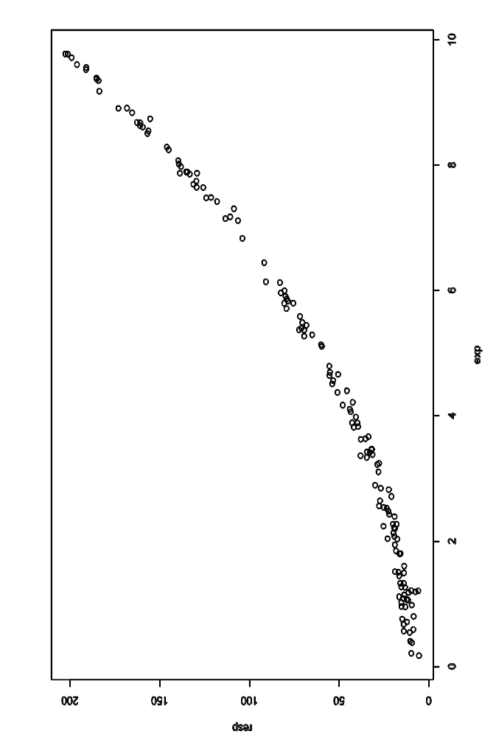
Another Example
Suppose we have an explanatory and response variable and would like to know if there is a significant linear relationship
Graphical display
January 6, 2009 - morning session

Slide 17
Numerical Summary
Numerical summary
  Correlation = 0.971
  R² = 0.942
  Response = -21.19 + 19.63*explanatory
For each additional unit of the explanatory variable, the response variable increases by 19.63 minutes
When the explanatory variable has a value of 0, the response variable has a value of -21.19
January 6, 2009 - morning session

Slide 18
Hypothesis testing
To test the significance of ¯₁
  H₀ = there is no linear relationship between the explanatory and response (¯₁ = 0)
  H₁ = there is a linear relationship between the explanatory and response (¯₁ ≠ 0)
Test statistic: t = 49.145
P-value = 0.000
It appears as though there is a significant linear relationship between the variables
January 6, 2009 - morning session

Slide 19
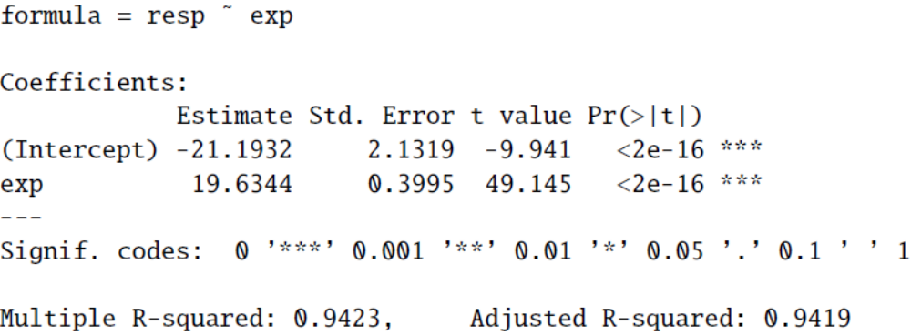
Sample Output
Sample output for this example, we can see both coefficients are highly significant
January 6, 2009 - morning session

Slide 20
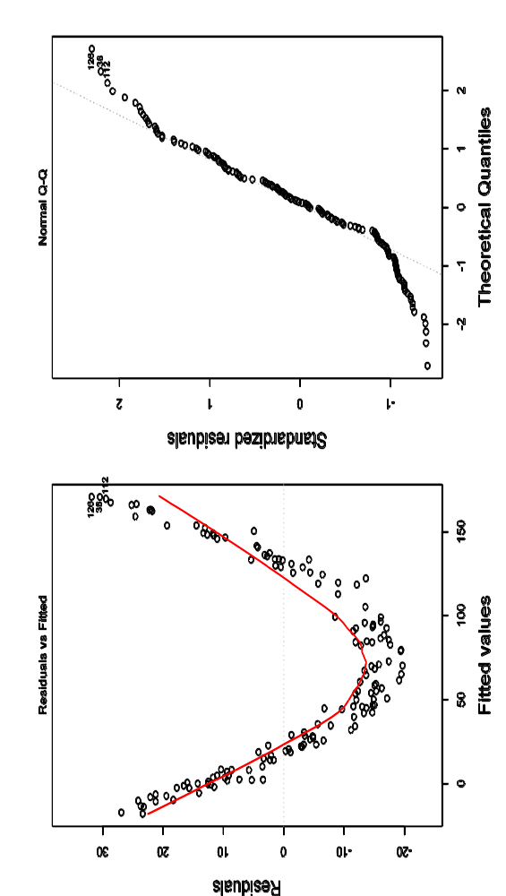
Checking Assumptions
Checking assumptions
  Plot on left: residual vs. predicted
    Want to see no pattern
  Plot on right: normal probability plot
    Want to see points fall on line
January 6, 2009 - morning session

Slide 21
Example 6 (cont)
Checking assumptions
  In the residual vs. predicted plot we see that the residual values are higher for lower and higher predicted values and lower for values in the middle
  In the normal probability plot we see that the points are falling off the lines at the two ends
This indicates that one of the assumptions was not met!
In this case the is a quadratic relationship between the variables
  With experience you’ll be able to determine what relationships are present given the residual versus predicted plot
January 6, 2009 - morning session

Slide 22
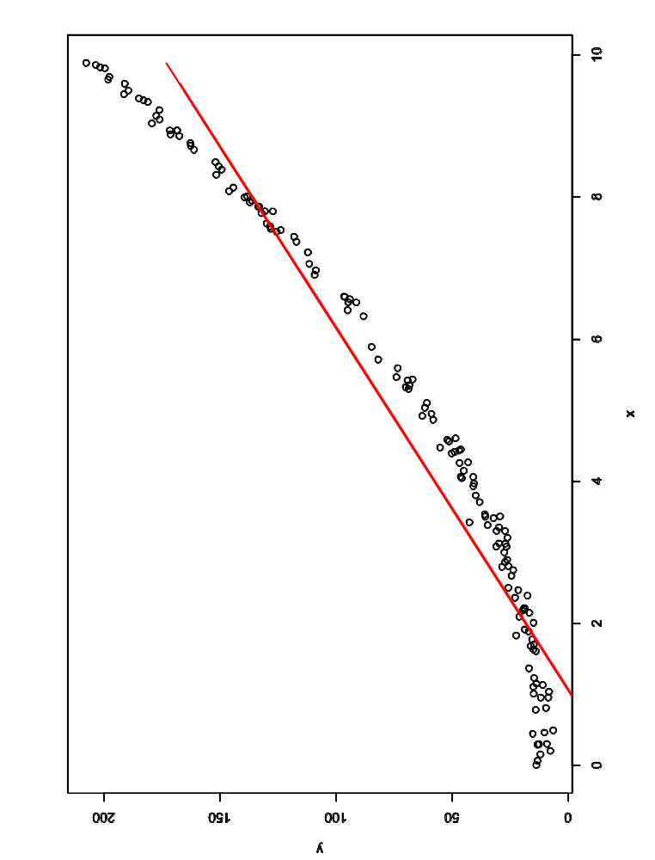
Data with Linear Prediction Line
When we add the predicted linear relationship, we can clearly see misfit
January 6, 2009 - morning session

Slide 23
Multiple Linear Regression
Use more than one explanatory variable to explain the variability in the response variable
Regression Equation
  Y = ¯₀ + ¯₁¢X₁ + ¯₂¢X₂ + . . . + ¯_{N}¢X_{N}
¯_{j} is the change in the response variable (Y) when X_{j} increases by 1 unit and all the other explanatory variables remain fixed
January 6, 2009 - morning session

Slide 24
Exploratory Analysis
Graphical Display
  Look at the scatter plot of the response versus each of the explanatory variables
Numerical Summary
  Look at the correlation matrix of the response and all of the explanatory variables
January 6, 2009 - morning session

Slide 25
Assumptions of Multiple Linear Regression
Same as simple linear regression!
  Linearity
  Independence of errors
  Homoscedasticity (constant variance)
  Normality of errors
Methods of checking assumptions are also the same
January 6, 2009 - morning session

Slide 26
R²adj
R² is the fraction of the variation in the response variable that can be explained by the model
When variables are added to the model, R² will increase or stay the same (it will not decrease!)
  Use R²adj which adjusts for the number of variables
  Check to see if there is a significant increase
R²adj is a measure of the predictive power of our model, how well do the explanatory variables collectively predict the response
January 6, 2009 - morning session

Slide 27
Inference in Multiple Regression
Step 1
  Does the data provide evidence that any of the explanatory variables are important in predicting Y?
    No – none of the variables are important, the model is useless
    Yes – at least one variable is important, move to step 2
Step 2
  For each explanatory variable X_{j}: does the data provide evidence that X_{j} has a significant linear effect with Y, controlling for all the other variables
January 6, 2009 - morning session

Slide 28
Step 1
Test the overall hypothesis that at least one of the variables is needed
  H₀: none of the explanatory variables are important in predicting the response variable
  H₁: at least one of the explanatory variables is important in predicting the response variable
Formally done with an F-test
  We will skip the calculation of the F-statistic and p-value as they are given in output
January 6, 2009 - morning session

Slide 29
Step 2
If H₀ is rejected, test the significance of each of the explanatory variables in the presence of all of the other explanatory variables
Perform a T-test for the individual effects
  H₀: X_{j} is not significant to the model
  H₁: X_{j} is significant to the model
January 6, 2009 - morning session

Slide 30
Example
Earlier we looked at how typing speed and efficiency are linearly related
Now we want to see if adding GPA (on a 0-5 point scale) as an explanatory variable will make the model more predictive of efficiency
January 6, 2009 - morning session

Slide 31
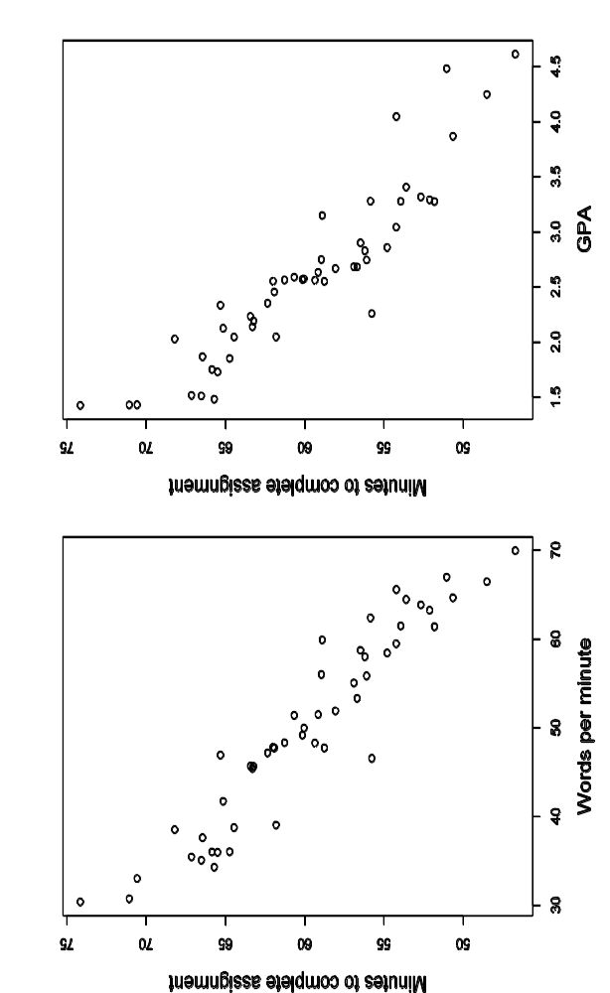
Graphical displays
January 6, 2009 - morning session

Slide 32
Numerical Summary
 | Efficiency | Words per minute | GPA
Efficiency | 1.00 | -0.95 | -0.92
Words per minute |  | 1.00 | 0.96
GPA |  |  | 1.00
January 6, 2009 - morning session

Slide 33
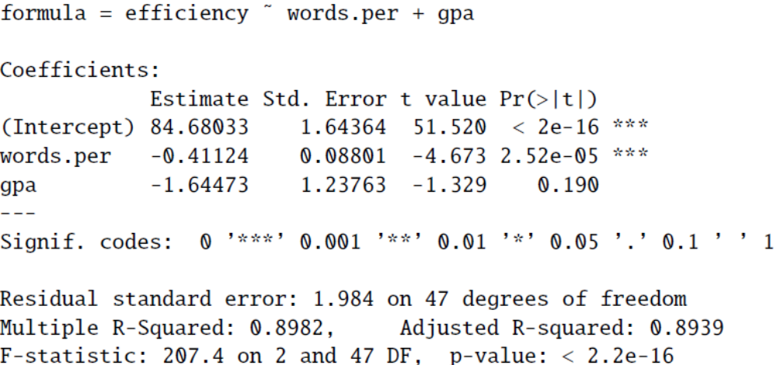
Sample Output
January 6, 2009 - morning session

Slide 34
Step 1 – Overall Model Check
For our example with words per minute and GPA, the F-test yields
  F-statistic: 207.4
  P-value = 0.0000
Interpretation, at least one of the variables (words per minute and GPA) are important in predicting efficiency
January 6, 2009 - morning session

Slide 35
Step 2
Test significance of words per minute
  T-statistic: -4.67
  P-value = 0.0000
Test significance of GPA
  T-statistic: -1.33
  P-value = 0.1900
Conclusions
  Words per minute is significant but GPA is not
  In this case we ended up with a simple linear regression with words per minute as the only explanatory variable
January 6, 2009 - morning session

Slide 36
Looking at R²adj
R²adj (wpm and GPA) = 89.39
R²adj (wpm) = 89.22
Adding GPA to the model only raised the R²adj by 0.17%, not nearly enough to justify adding GPA to the model
  This agrees with the hypothesis testing on the previous page
January 6, 2009 - morning session

Slide 37
Automatic methods
Model Selection – compare models to determine which best fits the data
Uses one of several criteria (R²adj, AIC score, BIC score) to compare models
Often use stepwise regression
  Start with no variables, add variables one at a time until there is no significant change in the selection criteria
  Start with all variables, remove variables one at a time until there is no significant change in the selection criteria
Packages have built in methods for this
January 6, 2009 - morning session

Slide 38
Multicollinearity
Collinearity refers to the linear relationship between two explanatory variables
Multicollinearity is more general and refers to the linear relationship between two or more explanatory variables
January 6, 2009 - morning session

Slide 39
Multicollinearity
Perfect multicollinearity – one of the variables is a perfect linear function of other explanatory variables, one of the variables must be dropped
  Example: using both inches and feet
Near-perfect multicollinearity – occurs when there are strong, but not perfect linear relationships among the explanatory variable
  Example: Height and arm spread
January 6, 2009 - morning session

Slide 40
Collinearity Example
An instructor wants to predict final exam grade and has the following explanatory variables
  Midterm 1
  Midterm 2
  Diff = Midterm 2 – Midterm 1
Diff is a perfect linear function of Midterm 1 and Midterm 2
  Drop diff from the model
  Use Diff but neither Midterm 1 or Midterm 2
January 6, 2009 - morning session

Slide 41
Indicators of Multicollinearity
Moderate to high correlations among the explanatory variables in the correlation matrix
The estimates of the regression coefficients have surprising and/or counterintuitive values
Highly inflated standard errors
January 6, 2009 - morning session

Slide 42
Indicators of Multicollinearity
The correlation matrix alone isn’t always enough
Can calculate the tolerance, a more reliable measure of multicollinearity
  Run the regression with X_{j} as the response versus the rest of the explanatory variables
  Let R²j be the be the R² value from this regression
  Tolerance (X_{j}) = 1 – R²j
  Variance Inflation Factor (VIF)= 1/Tolerance
Do more checking if the tolerance is less than 0.20 or VIF is greater than 5
January 6, 2009 - morning session

Slide 43
Back to Example
Use GPA as the response and words per minute as the explanatory
  R² = 0.91
  Tolerance (GPA) = 0.09
  Well below 0.30!
Adding GPA to the regression equation does not add to the predictive power of the model
January 6, 2009 - morning session

Slide 44
What can be done?
Drop the correlated variables!
Interpretations of coefficients will be incorrect if you leave all variables in the regression.
Do model selection (same as that on slide 37)
January 6, 2009 - morning session

Slide 45
Example
Suppose we have an online math tutor and classroom performance variables and we’d like to predict final exam scores.
Math tutor variables
  Time spent on the tutor (minutes)
  Number of problems solved correctly
Classroom variable
  Pre-test score
Response variable
  Final exam score
January 6, 2009 - morning session

Slide 46
Example
Exploratory analysis – correlation matrix
  The correlation between pretest and number correct seems high
 | Final Score | Pretest | Number Correct | Time
Final Score | 1.00 | 0.85 | 0.82 | 0.37
Pretest |  | 1.00 | 0.90 | 0.01
Number Correct |  |  | 1.00 | 0.03
Time |  |  |  | 1.00
January 6, 2009 - morning session

Slide 47
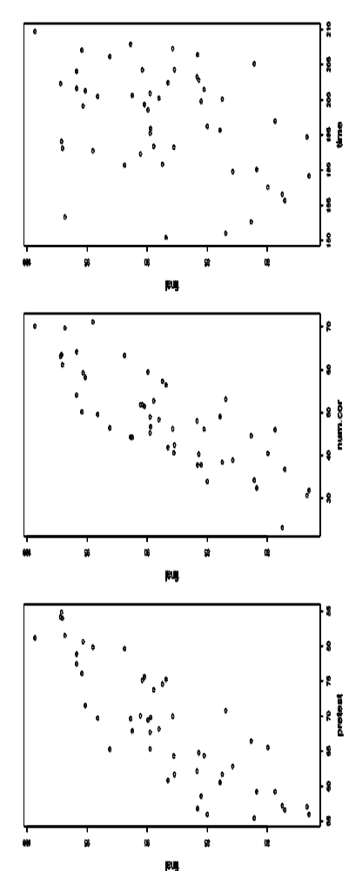
Example
Exploratory analysis
  linear relationship between time and final
  is not strong
January 6, 2009 - morning session

Slide 48
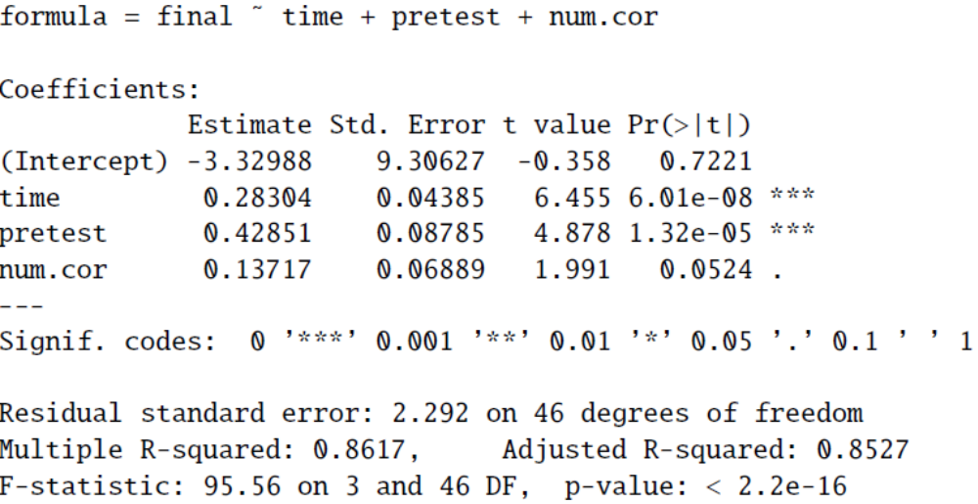
Example
Run the linear regression using pretest, number correct, and time as linear predictors of final score
January 6, 2009 - morning session

Slide 49
Step 1
Test the overall hypothesis that at least one of the variables is needed
  H₀: none of the explanatory variables are important in predicting the response variable
  H₁: at least one of the explanatory variables is important in predicting the response variable
F-statistic = 95.56
P-value = 0.0000
At least one of the three explanatory variables is important in predicting final exam score
January 6, 2009 - morning session

Slide 50
Step 2
Test significance of pretest score
  T-statistic: 4.88
  P-value = 0.0000
Test significance of number correct
  T-statistic: 1.99
  P-value = 0.0524
Test significance of time
  T-statistic: 6.45
  P-value = 0.0000
Conclusions
  Pretest score and time are significant but number correct is not
January 6, 2009 - morning session

Slide 51
Example
This is not surprising given the high correlation (0.90) between pretest score and number correct
Formally show
  Number Correct ~ Pretest + Time
  R² = 0.8044
  Tolerance = 1 – 0.8044 = 0.1956
    Lower than 0.20
  VIF = 1/0.1956 = 5.11
    VIF is greater than 5
January 6, 2009 - morning session

Slide 52
Model Selection
Why was test number correct and not pretest chosen as insignificant? Depends on which variable adds more to the predictive power of the regression equation
Doing stepwise regression will yield more information
Depending on the criteria used, some model selection procedures dropped number correct and others kept all three variables
  If we decide to drop number correct we will have to rerun the regression
January 6, 2009 - morning session

Slide 53
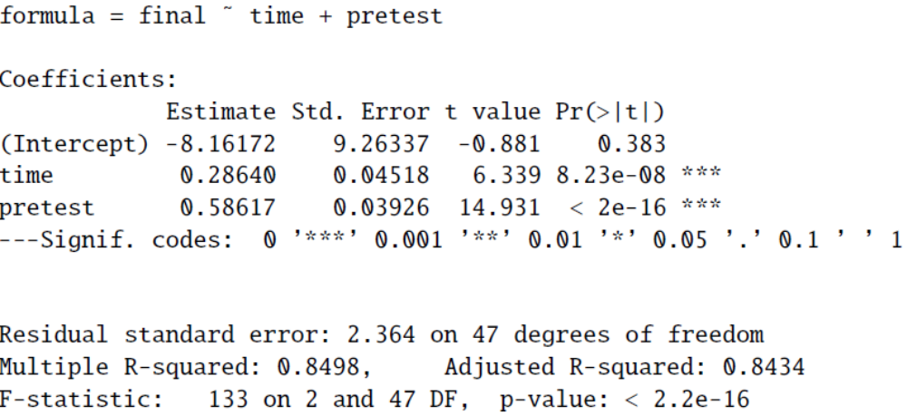
Rerunning the regression
New output
January 6, 2009 - morning session

Slide 54
Steps 1 and 2
Step 1
  F-statistic = 133
  P-value = 0.0000
Step 2
  Test significance of pretest score
    T-statistic: 14.93
    P-value = 0.0000
  Test significance of time
    T-statistic: 6.34
    P-value = 0.0000
January 6, 2009 - morning session

Slide 55
Example
Conclusion – both pretest score and time are important predictors of final exam score
R²adj = 84.34
  84% of the variability in final exam score is explained by pretest score and time
January 6, 2009 - morning session

Slide 56
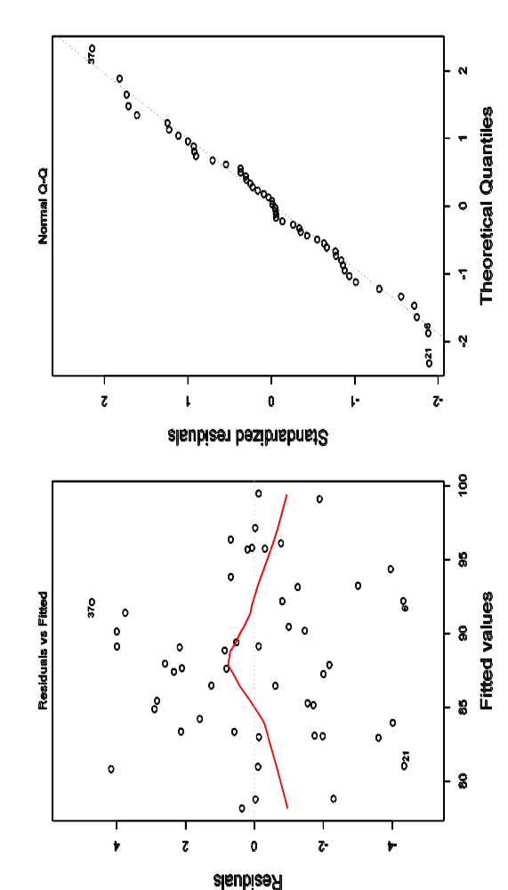
Check Assumptions
There may be a slight pattern to the residual vs. fitted plot, but overall the plots look good
January 6, 2009 - morning session

Slide 57
Interpretation
The final regression equation is:
For each additional point on the pretest, a student’s predicted final exam score increases by 0.59 points, holding time on the tutor constant
For each additional minute on the tutor, a student’s predicted final exam score increases by 0.29 points, holding pretest score constant
January 6, 2009 - morning session

Slide 58
Notes on Example
If either pretest or time was found to be non-significant, we would have rerun the regression again
Multiple regression often takes several regressions before we are done
The built in automatic model selection in statistical packages will do these in one step!
January 6, 2009 - morning session

Slide 59
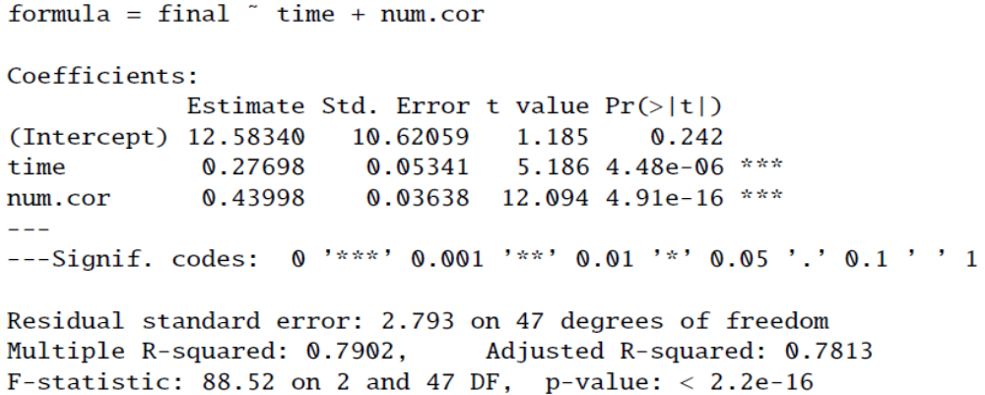
Alternate Ending
What if we had dropped pretest instead of number correct?
The regression equation would be:
January 6, 2009 - morning session

Slide 60
Steps 1 and 2
Step 1
  F-statistic = 88.52
  P-value = 0.0000
Step 2
  Test significance of number correct score
    T-statistic: 12.09
    P-value = 0.0000
  Test significance of time
    T-statistic: 5.19
    P-value = 0.0000
January 6, 2009 - morning session

Slide 61
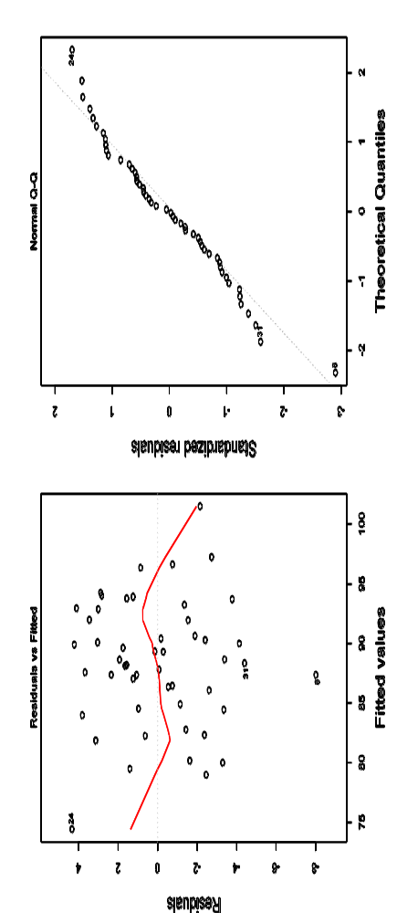
Check the Assumptions
On the residual vs. predicted there is a slight pattern. I’d recommend dropping the outlier and rerunning the regression.
January 6, 2009 - morning session

Slide 62
Notes
We can see that both pretest and time are significant but that the assumptions might be questionable
However, when the R²adj of this model with the previous model we see the different
  R²adj (pretest, time) = 84.34
  R²adj (Number correct, time) = 78.13
This model with pretest describes more of the variability in final exam scores
January 6, 2009 - morning session

Slide 63
Another Example
Suppose we have 4 explanatory variables (X₁, X₂, X₃, X₄) and we have our response variable Y
X₁ and X₃ appear to be highly correlated
 | Y | X₁ | X₂ | X₃ | X₄
Y | 1.00 | -0.36 | 0.76 | -0.38 | 0.54
X₁ |  | 1.00 | -0.33 | 0.98 | 0.09
X₂ |  |  | 1.00 | -0.34 | -0.12
X₃ |  |  |  | 1.00 | 0.08
X₄ |  |  |  |  | 1.00
January 6, 2009 - morning session

Slide 64
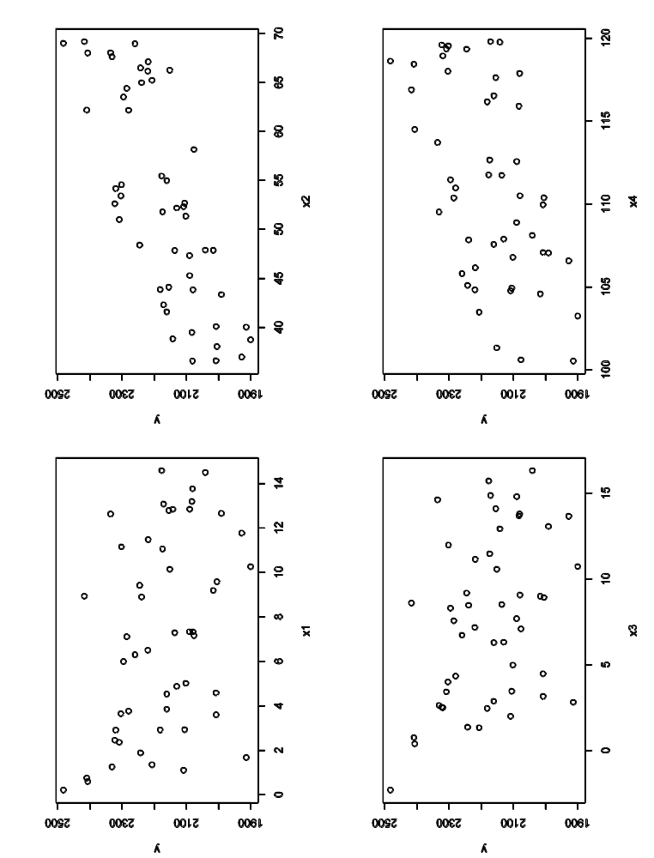
Exploratory Analysis
Appears reasonable that each of the 4 explanatory variables may have a linear relationship with the response variable
January 6, 2009 - morning session

Slide 65
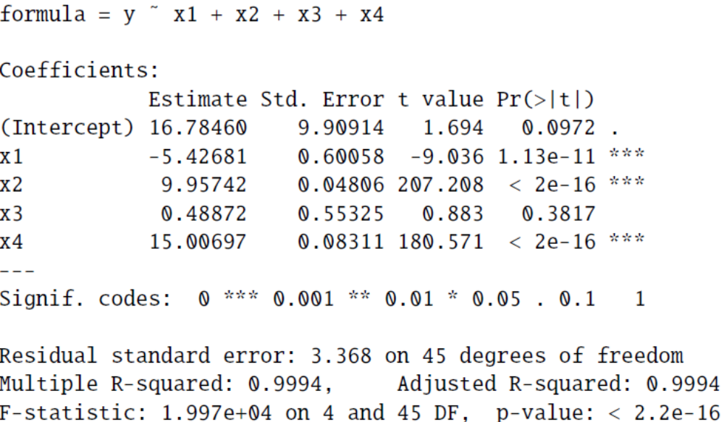
Example
Start by running the regression with all four explanatory variables
January 6, 2009 - morning session

Slide 66
Steps 1 and 2
Step 1
  F-statistic = 1900
  P-value = 0.0000
Step 2
  Test significance of X₁
    T-statistic: -9.04
    P-value = 0.0000
  Test significance of X₂
    T-statistic: 207.21
    P-value = 0.0000
  Test significance of X₃
    T-statistic: 0.88
    P-value = 0.3817
  Test significance of X₄
    T-statistic: 181.57
    P-value = 0.0000
January 6, 2009 - morning session

Slide 67
Conclusions
Variable X₃ is not significant in predicting Y
Calculate the tolerance for X₃
  X₃ ~ X₁ + X₂ + X₄
  R² = 0.96
  Tolerance = 0.04
  VIF = 25
Remove X₃ from the regression and rerun!
January 6, 2009 - morning session

Slide 68
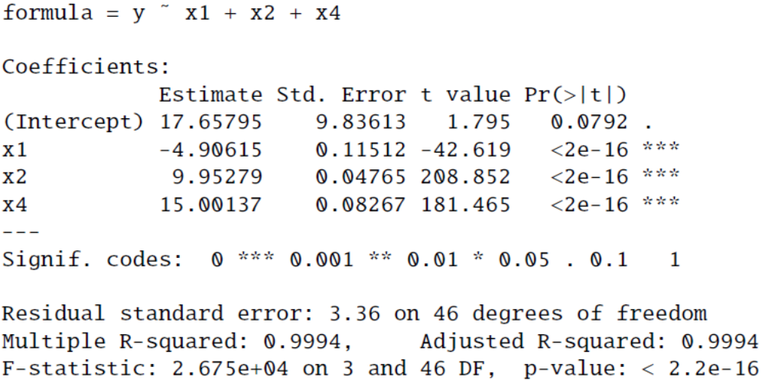
Updated Regression
R²adj= 99.94
  Note that the R²adj is the same as the regression with all four variables
January 6, 2009 - morning session

Slide 69
Steps 1 and 2
Step 1
  F-statistic = 2675
  P-value = 0.0000
Step 2
  Test significance of X₁
    T-statistic: -42.62
    P-value = 0.0000
  Test significance of X₂
    T-statistic: 208.82
    P-value = 0.0000
  Test significance of X₄
    T-statistic: 181.46
    P-value = 0.0000
January 6, 2009 - morning session

Slide 70
Things to Note
When we reran the regression without X₃, the changes in the regression equation and step 2 of the analysis were mostly to X₁
This is not surprising since it was X₁ and X₃ which were highly correlated
January 6, 2009 - morning session

Slide 71
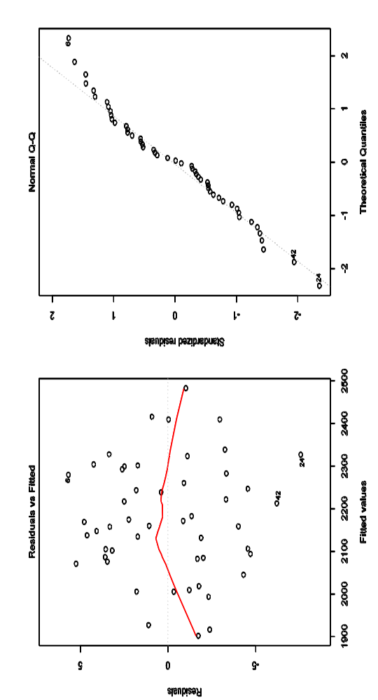
Check Assumptions
I would probably delete the low two observations in the residual vs. fitted plot and rerun
January 6, 2009 - morning session

Slide 72
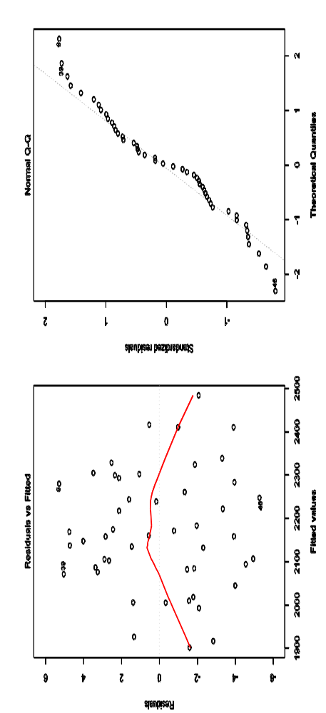
After removing observations
Step 1 significant
All three variables significant in Step 2
January 6, 2009 - morning session

Slide 73
Outliers
Removing observations in a linear regression is often subjective
Many packages will indicate observations which are possible outliers
Running a regression with and without the observations and comparing them is best
January 6, 2009 - morning session

